Slide 1
TITLE OF THE PROJECT RECOGNITION of sign language using 2D hand gesture-CNN approach
Second Review
Student name REG NO
FARAZ.G 18MIS1013
SONIA.P.U 18MIS1089
CHANDANA PRIYA.V 18MIS1091
SURYA SHEKAR.Y 18MIS1100

Slide 2
INTRODUCTION:
The project is about recognizing the gesture of the person and producing the output in the form of text which will be in human language.
Usually deaf people seek the help of sign language interpreters for translating their thoughts to normal people and vice versa.
But this system is very costly and does not work throughout the life period of a deaf person.
So, a system that helps this problem is necessary.
In this system, mainly our perspective is that deaf and dumb are unable to convey what they want say to another person .
But they can show a gesture by which the other person will be able to understand what he/ she is trying to say.
By which both the persons can understand and communicate easily.
For example : let us take a picture of a deaf person who is showing a silent sign which a normal human (who does not know the sign language) can’t understand what the deaf person is conveying. Now, the captured photo is uploaded in our website then it gets processed and shows the result in the text box: ”BE SILENT”.
Our website understand the gesture possessed by a man in the photo and it converts it in to text using cnn

Slide 3
OBJECTIVE:
Our objective is when a picture or photo is uploaded, to recognize the gesture and transform it in to natural processing language so that it can be understood by all the humans.
And when a text is uploaded to determine the meaning of the text and show the gesture for the same.

Slide 4
ABSTARCT:
Gesture recognition is a purely real time application. In gesture recognition we are going to analyze the picture or a photo which was captured by the camera and we are going to implement some image processing techniques to find out what the photo is conveying to us. We are going to recognize the gesture in the photo. Let us go into some brief explanation about what we are going to do. We have an interface of a Website which accepts a photo and box which looks like a comment box. User are going to capture a photo from camera and Users are going to upload the particular picture in to the website. Then the photo is gets processed and the result are shown in the text given below the image in the natural language( English). This will help deaf and dumb people as they cannot speak and convey what they wanted to say to the other person. They have a sign language but everyone cannot understand it. Our application works on digital image processing as well as the image classification.

Slide 5
Existing System:
In the existing system it recognizes that a group of people are present at a place but does not recognize what a particular person is trying to say.
It will not be much useful for people as they couldn’t find what a specific person is trying to say.
As there will be a sensor and the person would be in motion it cannot determine the exact gesture of a person.
When a person is trying to show something and due to some discrepancies if it doesn’t capture the exact gesture misunderstanding may take place between people and communication problem would occur.
Exactly, the same system is not proposed yet but similar systems are proposed to help deaf and dumb people.

Slide 6
LIMITATIONS OF EXISTING SYSTEM:
Images or video may not be under consistent lighting, or in the same location.
Items in the background or distinct features of the users may make recognition more difficult.
When there are group of people it couldn’t exactly determine the gesture of the person.

Slide 7
PROPOSED SYSTEM:
In our System there will be website where login is created for User.
The gesture given by a person will be uploaded in the website and it processes to give the meaning of it.
Using CNN and image classification the gesture created is converted and displays in the form of text which a person can understand.
Here the image is uploaded in the website there will not be any motion in the picture . So, it can give the meaning of the gesture appropriately.
And also, when a text is typed the gestures stored in database will display the appropriate one for the text given.
Due to this the misunderstanding in the gesture form will be decreased.
We are just going to convert the text in to gesture and the gesture in to text which will clear the doubts and misunderstanding.

Slide 8
Advantages of Proposed System:
Easily everyone can understand what the deaf and dumb people are saying as the out will in human language.
Both text and gesture can be accessed through our website.
Wrong detection of gestures will be less when compared to other systems.
Database will be storing some of gestures which would help people even more to understand well.
Update of gestures in to the database will be done according to the users view if required.

Slide 9
Algorithms/ Techniques :
Using Convolution Neural Network we determine the gesture.
OR
By using some image filtering techniques in deep neural networks.

Slide 10
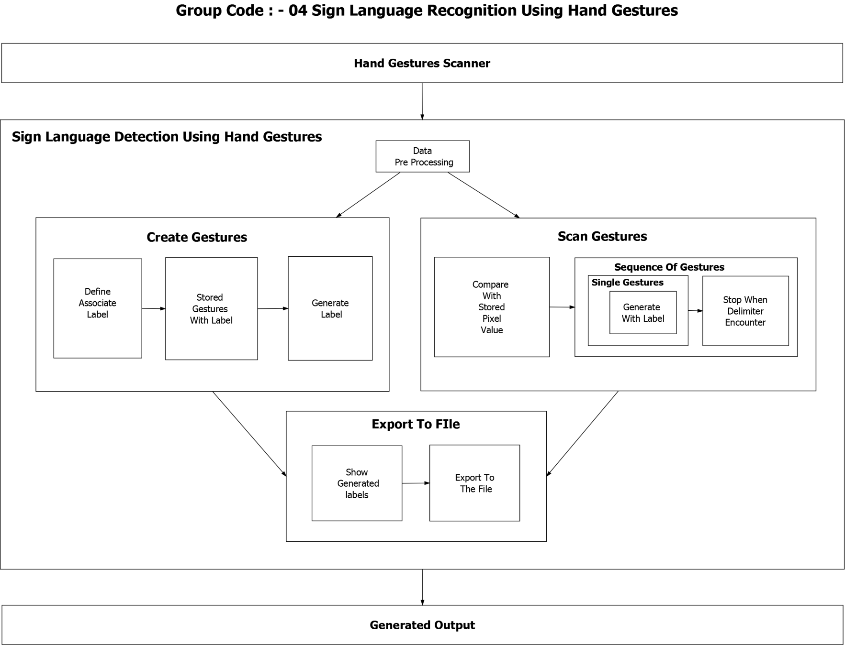
SYSTEM ARCHITECTURE:

Slide 11
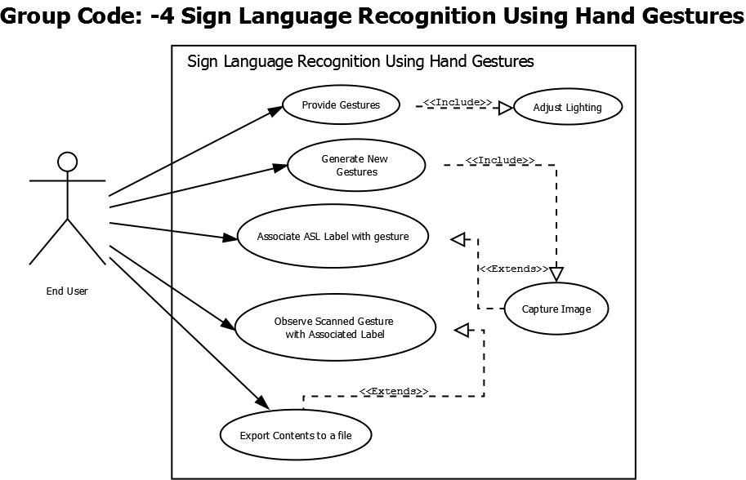
USE CASE:

Slide 12
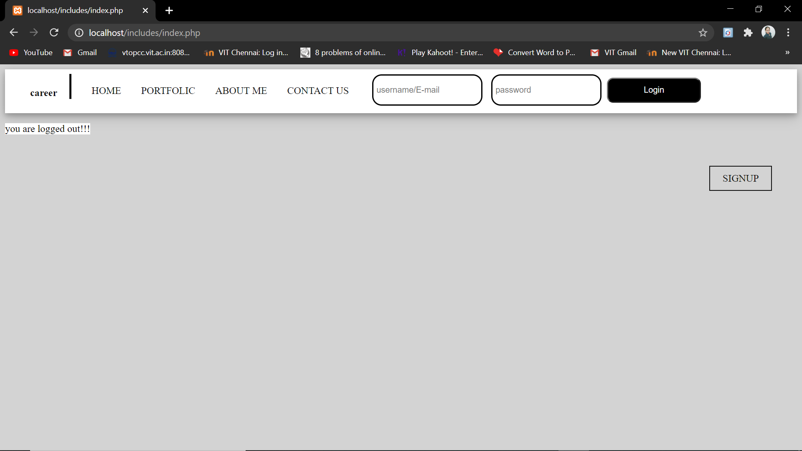
IMPLEMENTATION:

Slide 13
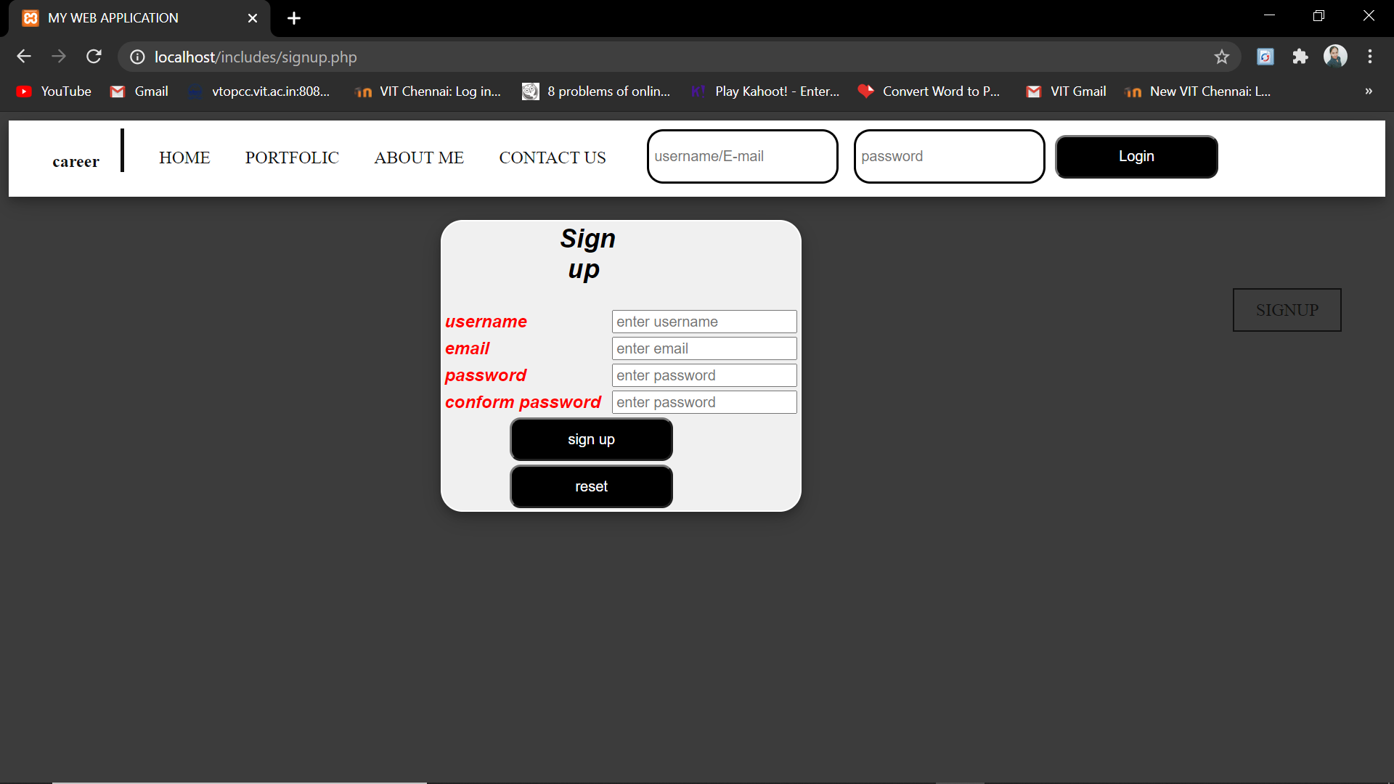
IMPLEMENTATION:

Slide 14
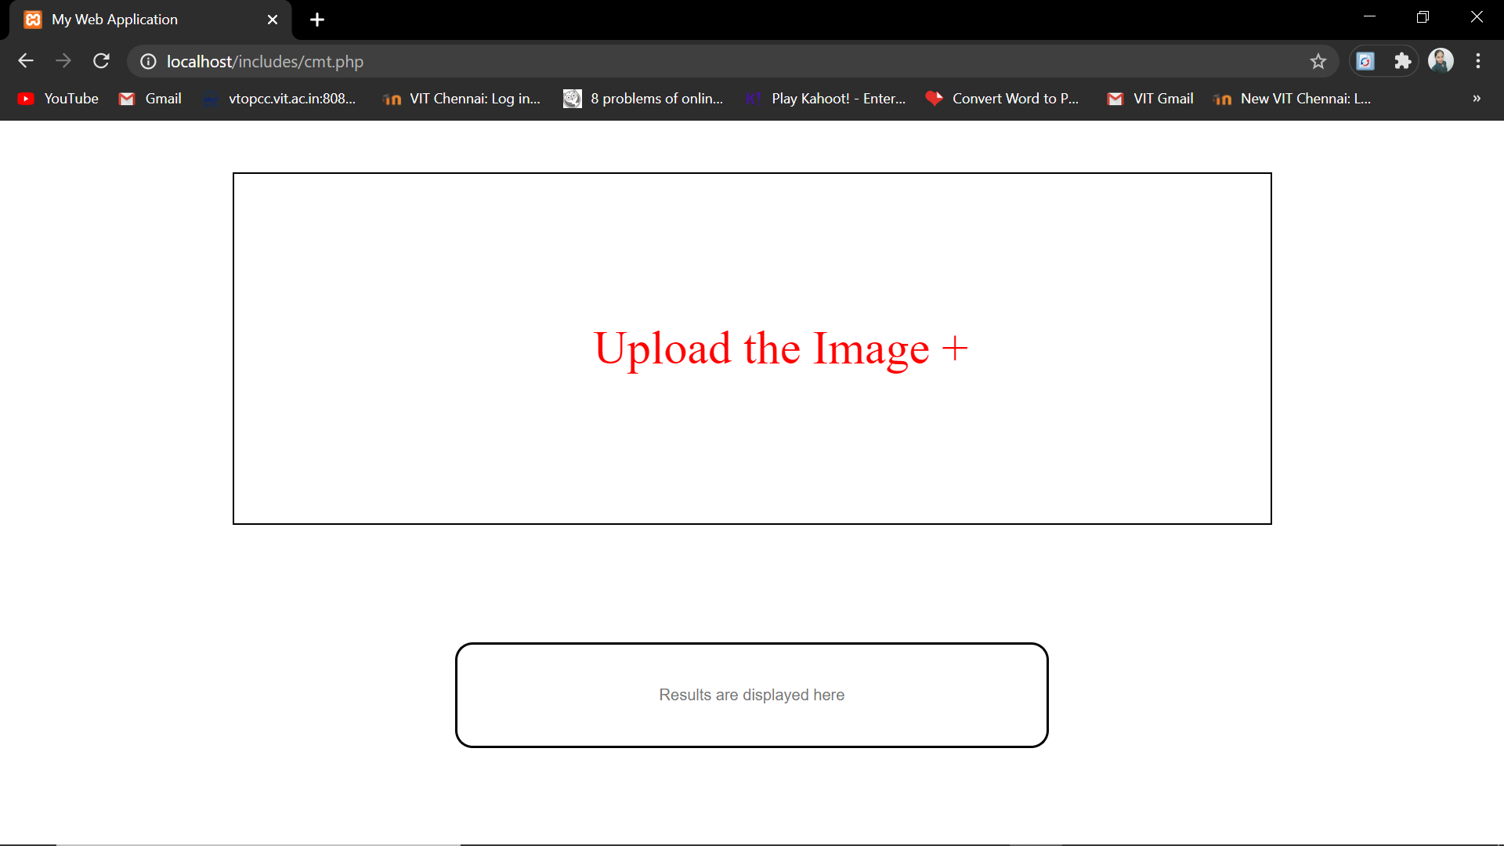
IMPLEMENTATION:

Slide 15
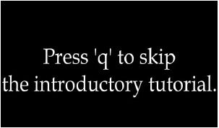
screenshots

Slide 17
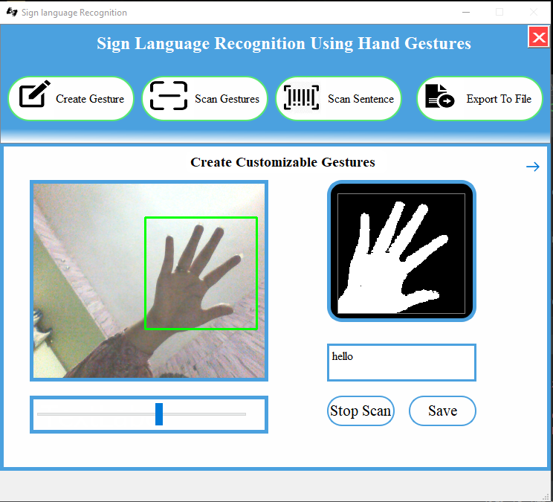
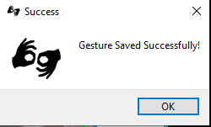

Slide 18
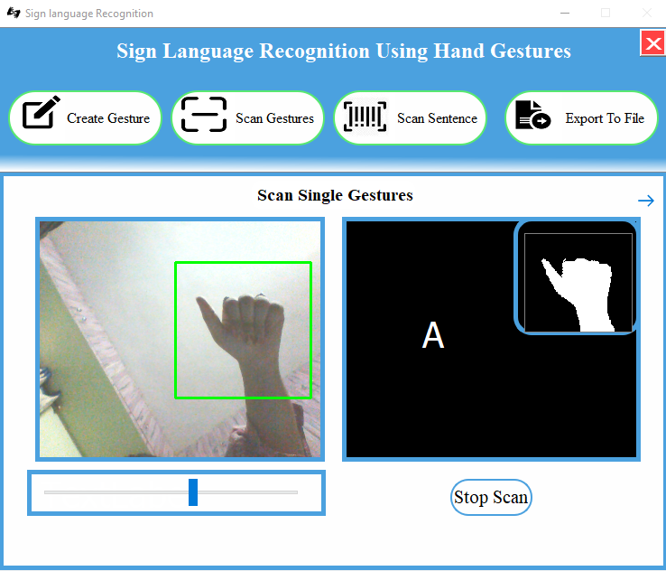

Slide 19
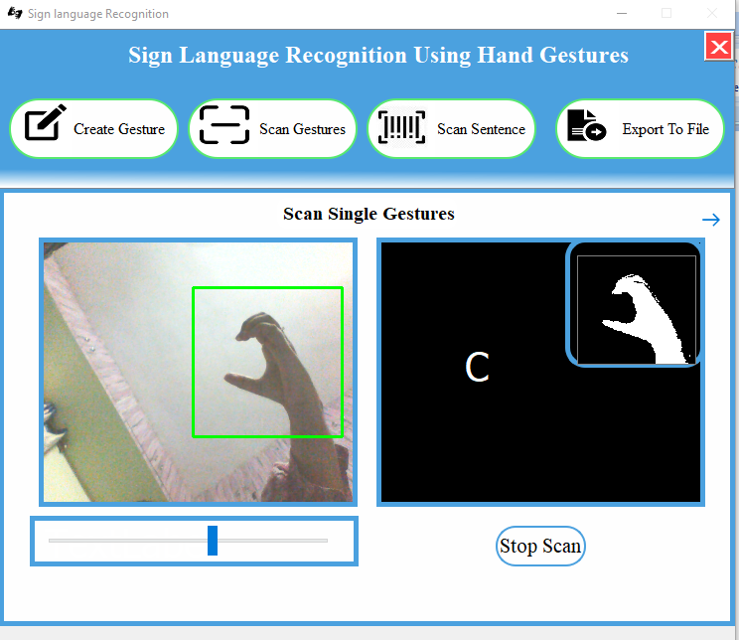

Slide 20
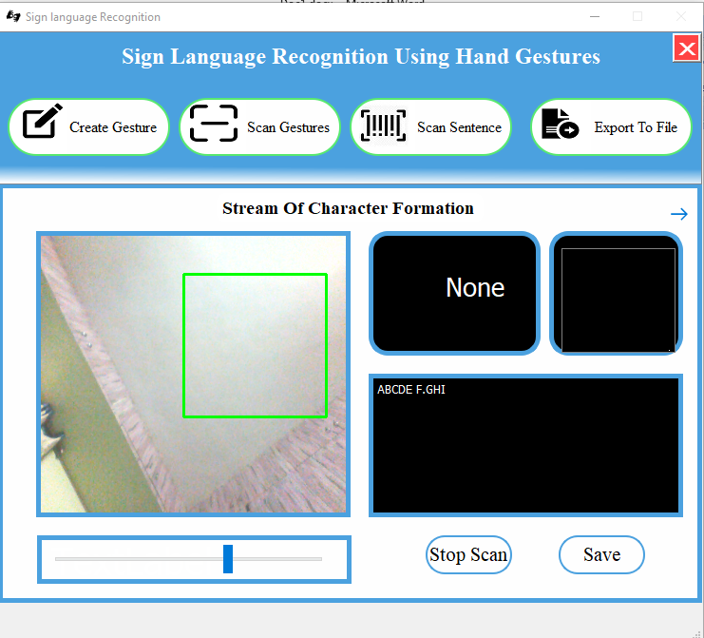
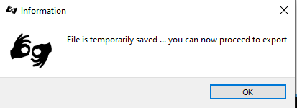

Slide 21
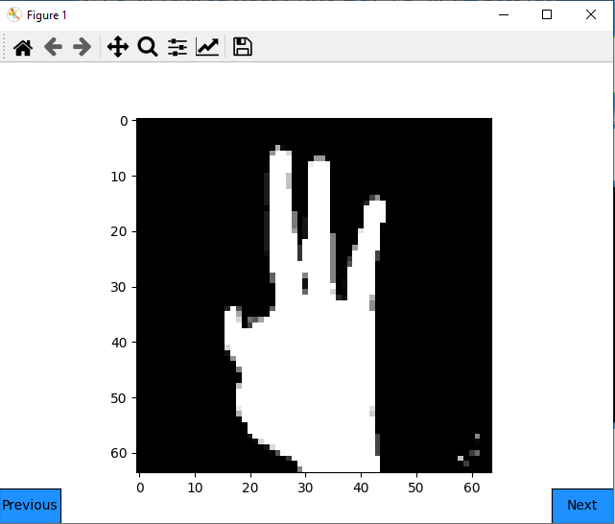

Slide 22
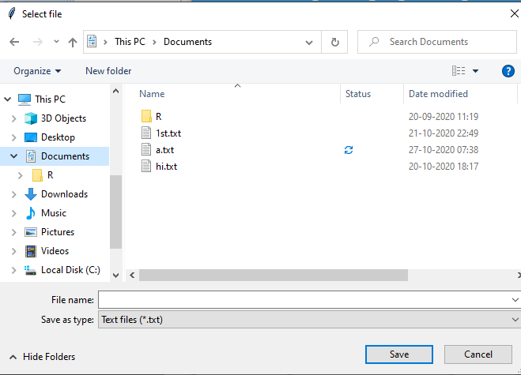
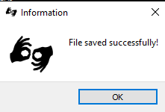

Slide 23
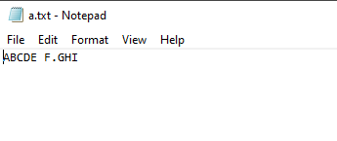

Slide 24
CONCLUSION:
we have proposed this system of shape based approach for gesture recognition.
The strength of this approach includes it’s simplicity, ease of implementation, and it does not require any significant amount of training or post processing.
This will be easy for people to use and understand. This will not take much time in conversion and displaying the output.
Easily a person who is deaf and dumb can communicate with other person who does not know the sign language or who doesn’t have any translator with them.
This doesn’t cost much as it costs when a translator works for them.
Misunderstandings in the communication between the people will also be less.

Slide 25
References:
[1]. R. S. Murthy & R. S. Jadon. (2009) “A Review of Vision Based Hand Gestures Recognition,” International Journal of Information Technology and Knowledge Management, Vol. 2, No. 2, pp 405-410.
[2]. Miss. KawadeSonam P, Prof. V. S. Ubale "Gesture
Recognition :A Review"(IOSR- JECE)ISSN:2278-
2834,ISBN:2278-8735, PP:19-26
[3] .Shaikh Shabnam,Dr. Shah Aqueel "Real Time Hand Gesture Recognition System: A Review" IJCSN,Volume 4, Issue 2, April 2015, ISSN (Online) : 2277-5420 .
[4]. Gongfa Li1, Heng Tang, Ying Sun, Jianyi Kong, Guozhang Jiang, Du Jiang, Bo Tao, Shuang Xu and Honghai Liu (2017), “Hand gesture recognition based on convolution neural network.” Cluster Computing, Springer doi: https://doi.org/10.1007/s10586-017- 1435-x.
[5]. Wenjin Tao, Ming C. Leu and Zhaozheng Yin b (2018), “American Sign Language alphabet recognition using Convolutional Neural Networks with multiview augmentation and inference fusion.” Engineering Applications of Artificial Intelligence 76 : 202–213.

